Slide 1
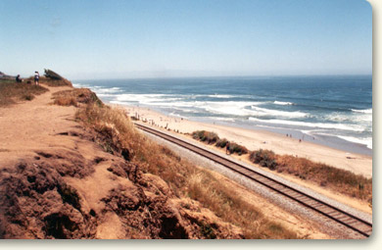
A vision for rail in Santa Cruz County
Bruce Sawhill, PhD

Slide 2
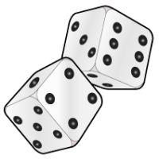

Making Rail Work
A great system is a matter of *luck
*Luck = Preparation meeting opportunity
Opportunity created by
Density pattern
Bad traffic
Practical options
A population ready and open to solutions
Changing State and Federal priorities/regulations
CA State Rail Plan “goes big” on rail statewide by 2040
Solution: Go where you want to go, often

Slide 3
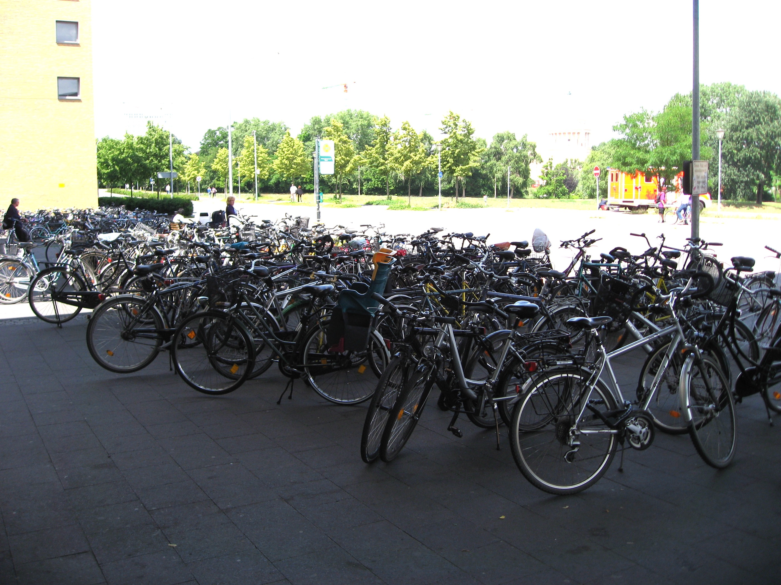
About Population Density
Not to be confused with population
A large population can be very spread out (Jacksonville, Fresno, San Antonio)—all over 1M people, very unsuitable for transit
Need dense population near a rail line PLUS
Places to go near a rail line PLUS
Ways to get to the rail line AND
A long skinny settlement pattern
Santa Cruz Co. checks all boxes

Slide 4
Density Maps ( Fresno) 972,000 people

Slide 5
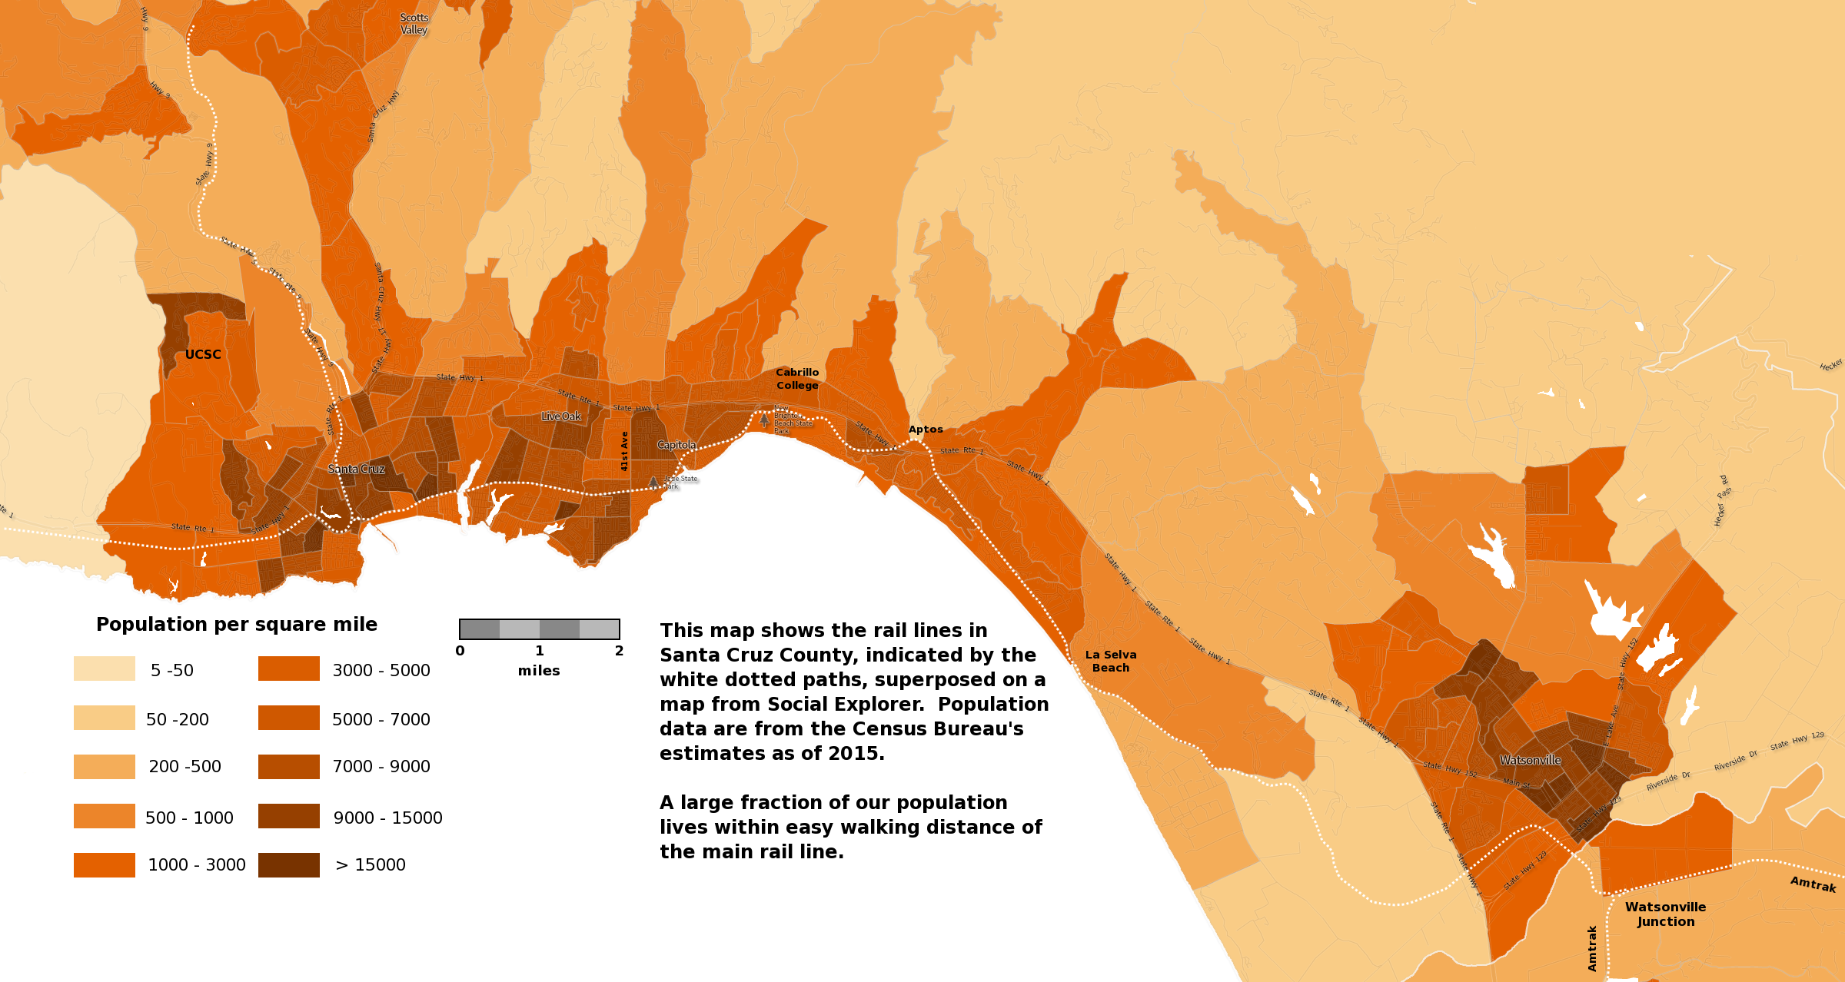
Density Maps (Santa Cruz) 250k people, 100+k in mid-County-rail lines dotted white
MapMap

Slide 6
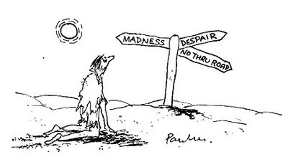
The Last Mile
Best if rail goes somewhere, not *near* somewhere. Somewhere = < 1 mile, pref. ½ mile. (28% SC pop ½ mile from RR, 50% 1 mile)
VTA = Example of what not to do (low ridership, heavy subsidy)
Traffic so bad, usage becoming decent anyway
Why not Airport?
3 trip legs to get from SJC to SC
In our area, this comes up for
UCSC
Marine Sciences Campus
Cabrillo College
Hospital/Medical Services area
Harvey West
Best solution is direct service
Second best is coordinated bus (UCSC, hospital, Harvey West)
Serve a smaller number of people well than many poorly ( unlike VTA)

Slide 7
Rail Spurs worth the effort These could add thousands of riders per day
UCSC - MS
0.4 – 0.5 mi
All on UCSC land
Cabrillo College
0.2 mi. plus freeway
Over/underpass

Slide 8
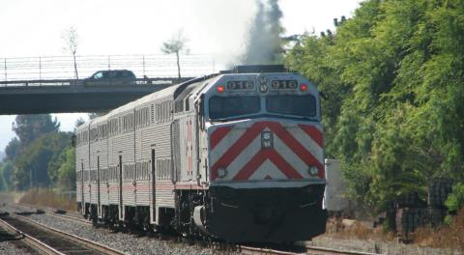
A train is a train is a train? Caltrain: Diesel powered, 460 tons (soon to be replaced by electric)

Slide 9
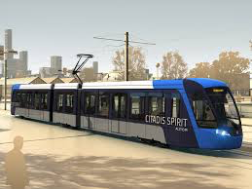
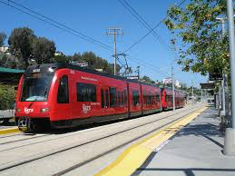
Explosion of new options since 2013 40-50 tons, electric, no locomotive
Streetcar w/Light Rail capability
Rapid acceleration
Rapid entry/exit
No-step boarding
Supercapacitor/battery options
Can carry up to 350 people
Made in USA (2018)
Light Rail (Sacramento):
Top Speed 65 mph
Can carry up to 660 people
Made in USA
Battery version tested in San Diego

Slide 10
New Technology
Batteries (in use in Dallas, elsewhere)
Supercapacitors (Europe)
Hidden 3rd rail
Inductive charging
Diesel/electric hybrid
Regenerative braking
Efficiencies from 300-1000 mpg/passenger
PTC

Slide 11

All aboard!

